Slide 1
Agenda
10:00-10:30 – Introductions & Roles - John
10:30-11:00 – Project Background – Tucker
11:00- 11:30 – Project Overview - Deb
11:30-12:00 - Timeline of activities and annual milestones - Tucker
12 noon to 12:30 – Lunch will be provided
12:30 to 2:30 – Objective 1 Approach & Discussion– John
Year 1 survey tools and farm selection process
Critique (strengths and limitations) of survey tools and study design
Notes:
Housekeeping topics
Location of restrooms
Hang up coats next to Dean’s office

Slide 2
Introductions and Roles
UVM Team
John Barlow, Deb Neher, Tucker Andrews, Juan Alvez, Jenn Colby, Tom Weicht, Colene Reed, graduate student TBD
Producers
Tyler Webb, Annie Claghorn, Miles Goodrich
Industry
Brian Jerose, Sarah Flack
John Cleary, Rachel Gilker
Science Team
Pam Adkins, Sandra Godden, Noah Fierer

Slide 3
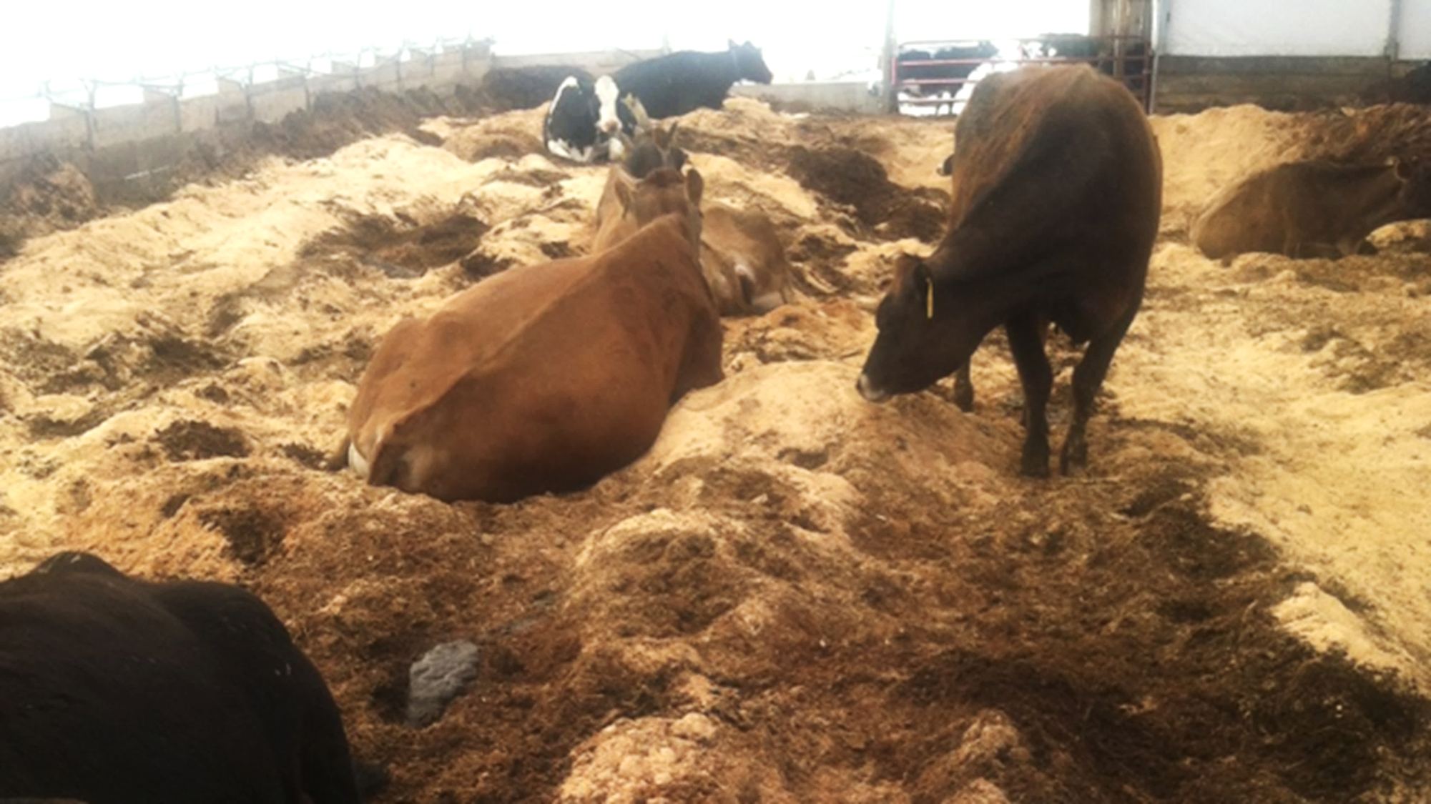
Despite living on a giant pile of their own manure and urine mixed with organic materials, cows on bedded pack do not necessarily experience more mastitis.
In fact, some research reports a decrease in mastitis after switching to bedded pack.

Slide 4
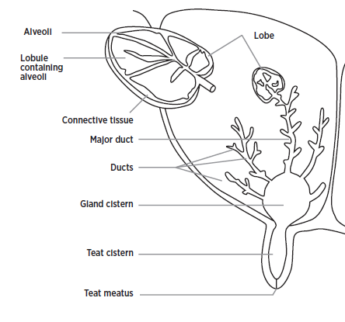

Teat Canal
Photo USDA-ARS
Michigan State University Extension
Notes:
A closer look at the mammary gland:
In the past 15 years, there has been an explosion in the use of DNA to assess the composition of the microbial community, allowing us to suggest an enormous diversity of microbial life far beyond that which can be grown in a petri dish. In the world of mastitis epidemiolygy this has lead to a reassessment of the nature of the host pathogen relationship. For many decades, healthy intramammary milk has been thought to be free of bacteria. Recent evidence has suggested that this may not be true. Instead, a diverse assemblage of microbial DNA has been observed in healthy milk, suggesting that the relationship between the udder and the microbial community may be more complex than "if a bacteria manages to establish itself in the gland, this gland is infected"

Slide 5
Traditional understanding
If a microbe(s) manages to establish itself in the gland, then this gland is infected
The dysbiosis hypothesis
The healthy gland contains microbes; infection is linked to a disruption of this ecosystem
Keeney, K.M., Yurist-Doutsch, S., Arrieta, M.-C., Finlay, B.B., 2014. Effects of Antibiotics on Human Microbiota and Subsequent Disease.
Notes:
The dysbiosis hypothesis, (“Put this in the back of your mind for a moment”)
disruption of the microbial ecology:
via invasion of a pathogen
“turning on” of pathogenicity of endogenous microbes,
or due to a chemical or physical imbalance in the gland, creating new ecological niches that allow commensal microbes to thrive, stimulating a greater cow immune response.

Slide 6
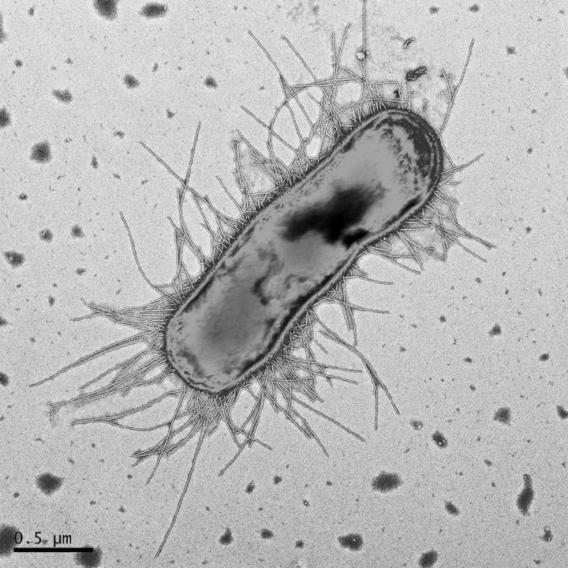
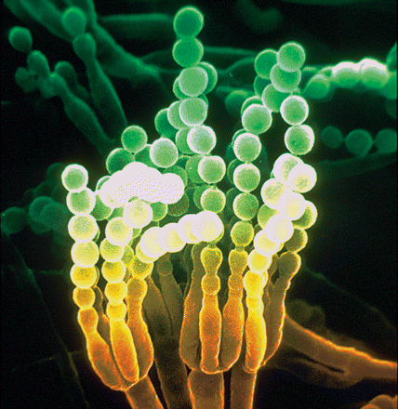
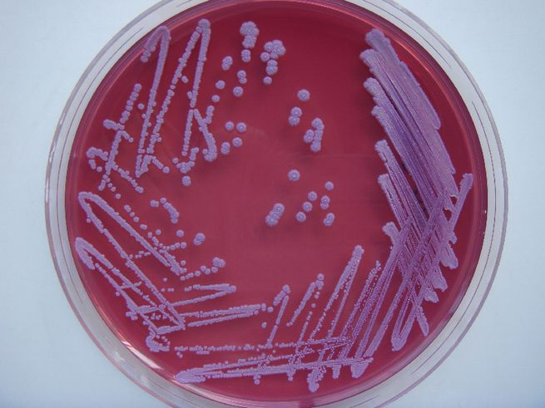

The Microbiome:
DNA-based Best Guess!
Dagmara Kisiela
USDA-ARS
L. Carrete
vs.
Notes:
Not counting microbes, only unique fragments of their DNA. So our long list of organism names that we found in these environments are best guesses. Often DNA sequences are identified only to order etc. For example, the jackalope DNA in our dataset is certainly a unique organism, but its DNA can only tell us it is related to the rabbit, because no one has ever found one before. So we are left calling it an OTU.
S aureus, penicillium chromogenes, escherichia coli

Slide 7

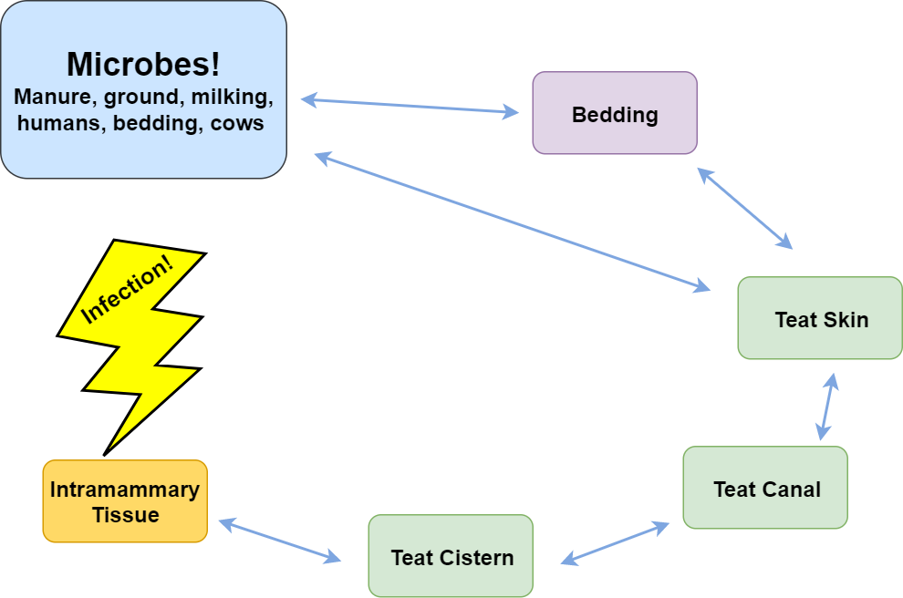
T. Andrews
Notes:
Organic farmers, such as those in this study, are unable to use antibiotics and rely on preventative measures to discourage mastitis. Bedding types and management can effect total pathogen load on teats and effect which bacteria are present in the bedding. Interestingly: the bedded pack style of bedding relies on the microbial community to decompose layers of substrate
Despite living on a pile of organic material mixed with their own feces, cows are no more likely experience mammary infections. What is going on here?

Slide 8
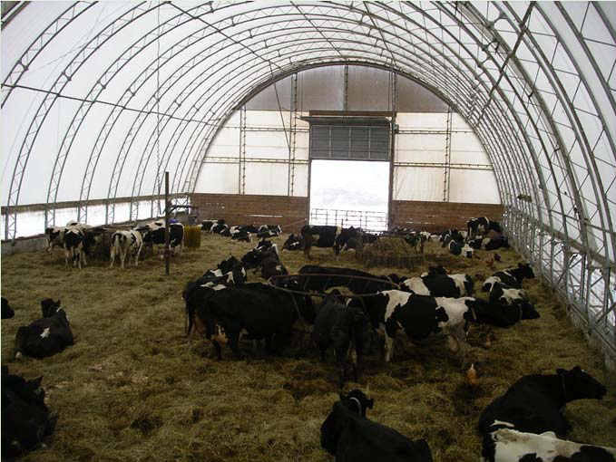
What bacteria and fungi are living in bedded pack, milk, and skin?
Do these organisms have an effect on mammary health?
Does bedding management change this community?
Questions
J. Colby
Notes:
We are hoping to gain insight into how bedded pack management can be used to control mastitis and curtail flies

Slide 9

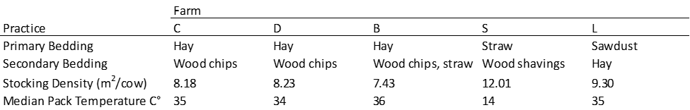
Experimental Design

Slide 10
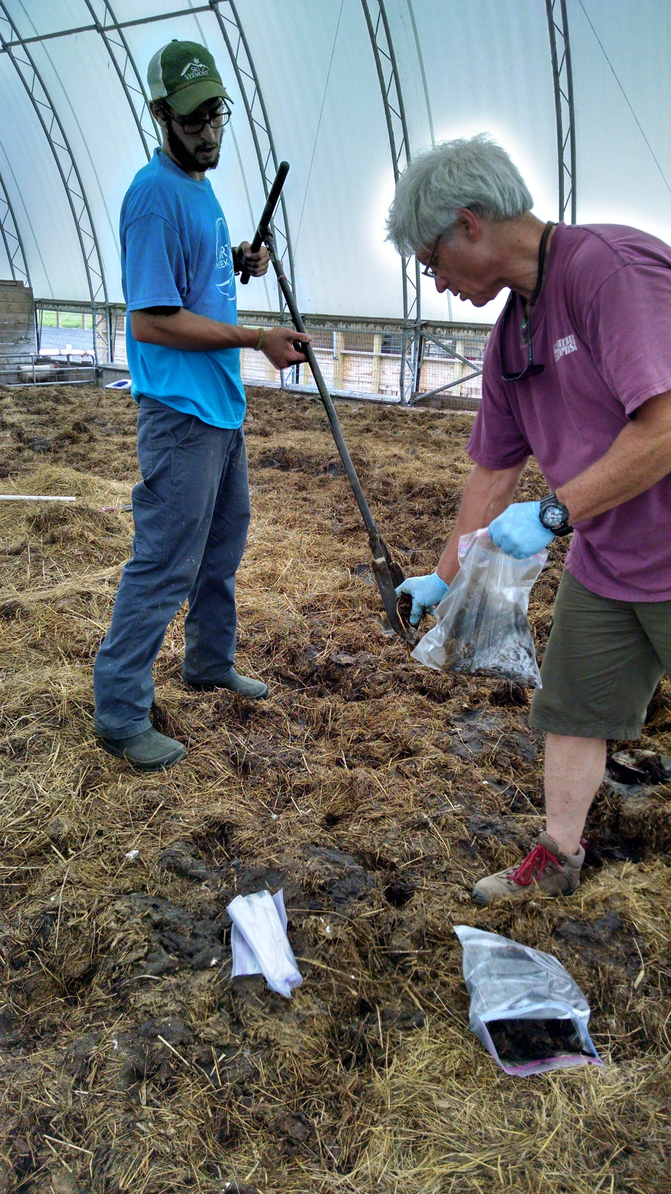
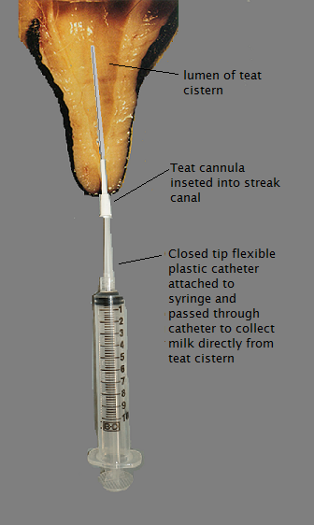
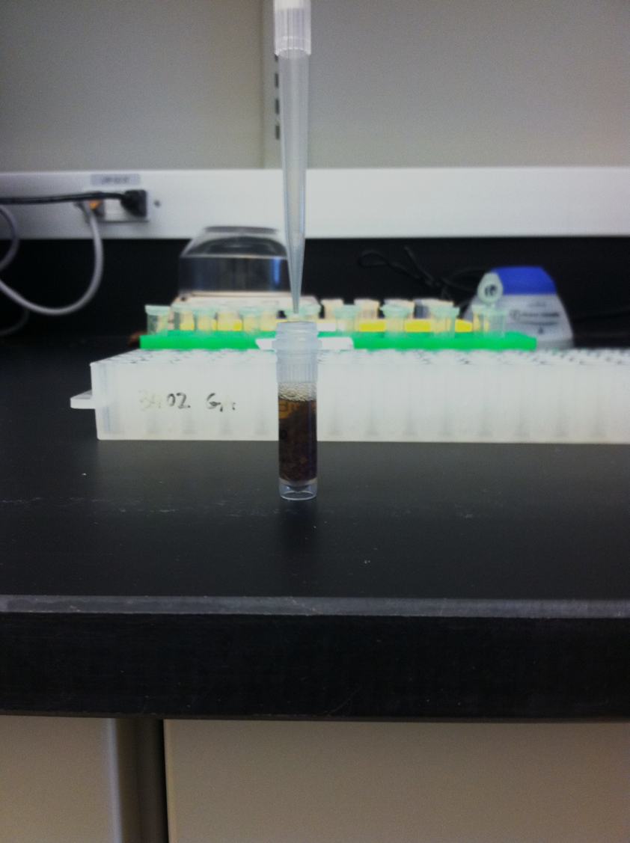
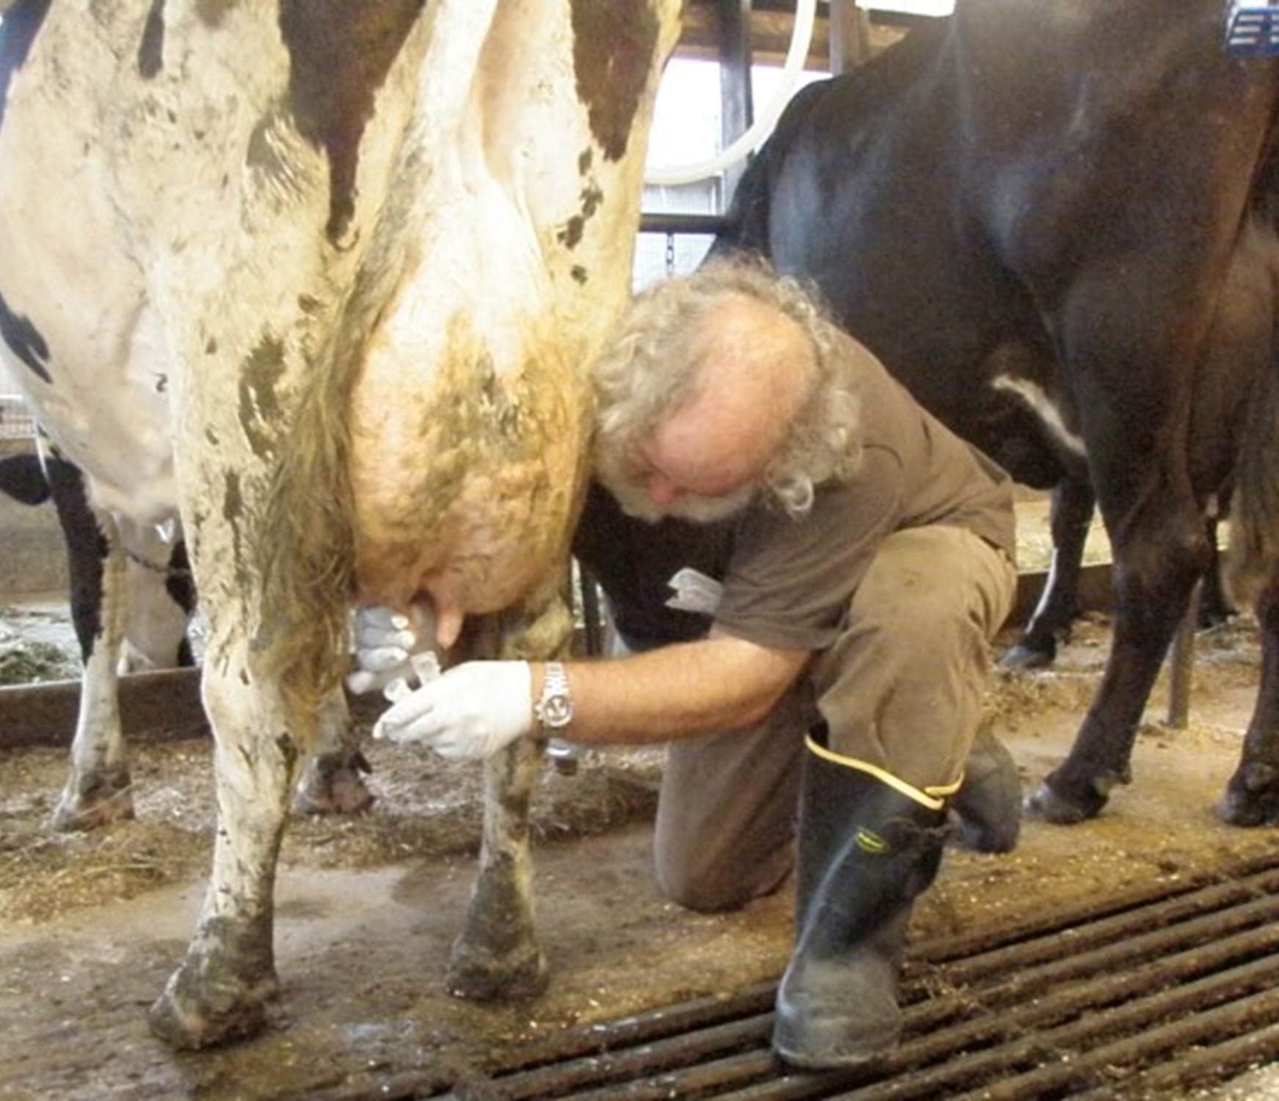
T. Andrews
J. Barlow
D. Neher
J. Barlow

Slide 11
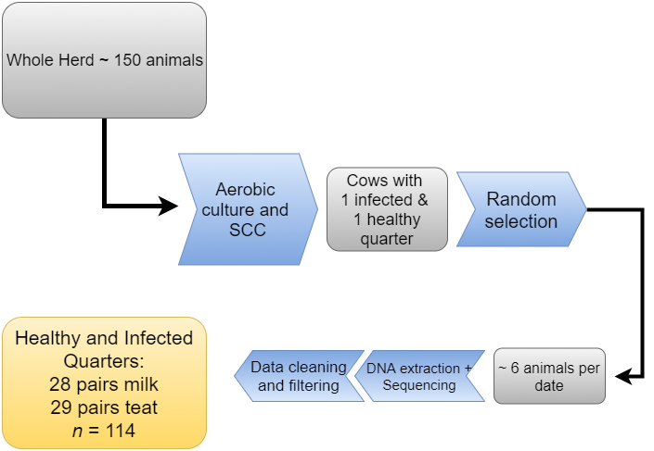
Notes:
Screened the herd to identify cows with one healthy and one infected quarter
Sequenced a random selection of these cows on each date.
Infected == SCC >= 200000 & positive ID of pathogen in replicate samples
Healthy == SCC <= 100000 & no growth in replicate samples

Slide 12
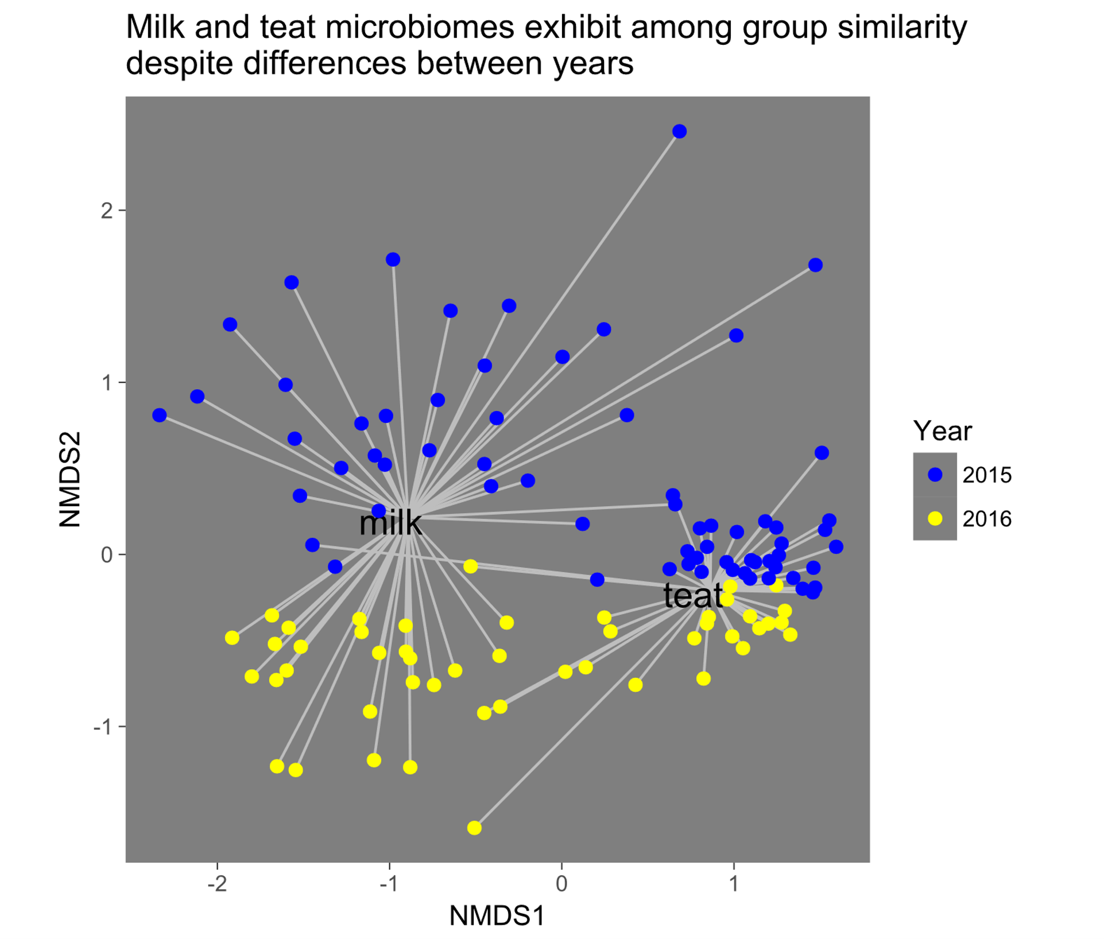
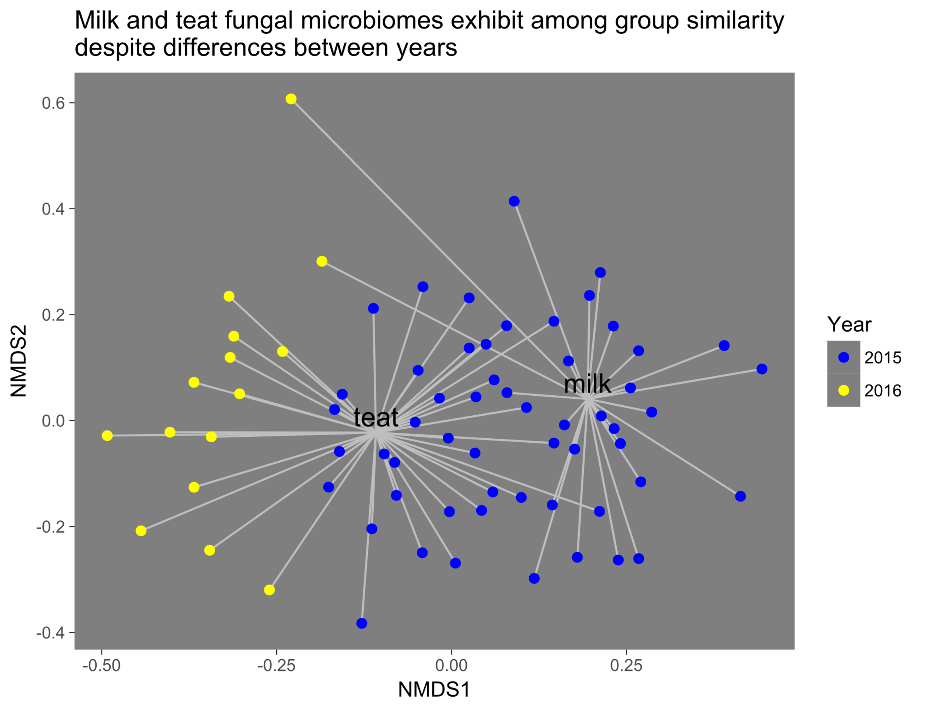
Microbiome differs between milk and teat
Bacteria
Fungi
Notes:
NMDS plots: points are samples of individual quarters, closer together means that samples have more similar microbiomes. line show the distance from the center of the sample type cluster
Milk and teat microbiomes are distinct.
Within sample type, 2015 and 2016 distinct: teat dipping? time effect? unclear: exactly confounded
For bacteria, milk microbiome exhibited more variability than teat, which are all quite closely clustered.

Slide 13
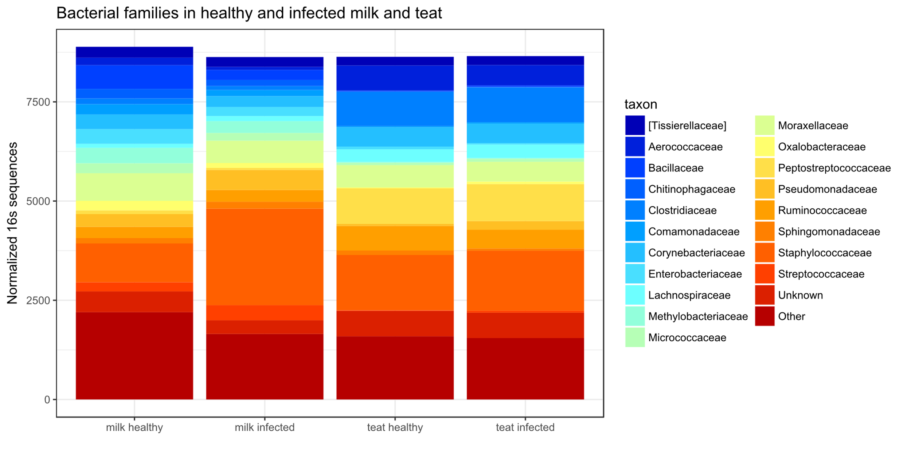
Infected milk microbiome is imbalanced
Notes:
Teat community similar
Milk community different: dominated by staph
Greater relative abundance of staphylococcaceae in infected milk, compresses other observed taxa. Unclear if they do not exist or less likely to be counted due to greater abundance of staph. Evenness of the infected community declines. Teat community is remains similarly distributed, and fewer taxa discrepancies are observed.

Slide 14
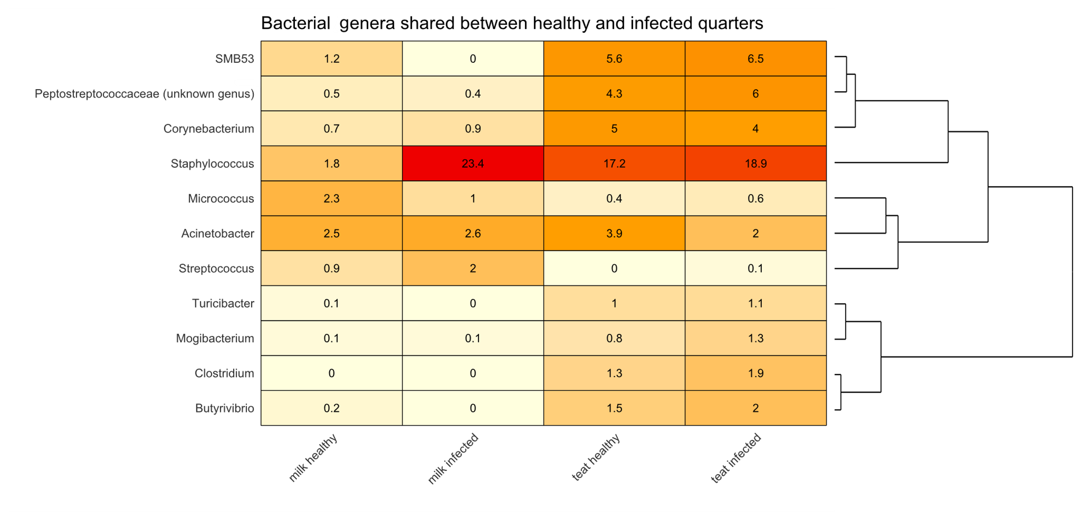
Milk microbiome changes in infected state
Notes:
Taxa shared between all states:
teat community similar between infection state. Milk community differs
Higher in healthy, almost zero in infected milk: suggests that infection status modulates the microbial DNA in the healthy milk:
Dysbiosis Hypothesis
Only 2015 above 1% RA.
OTUs in at least half of obs. Of all animals= common
Numbers are mean relative abundance in that habitat state
Heavy hitters: staph, micrococcus, Acinetobacter
SMB53 greater in healthy milk, common on skin
Staph, greater in infected milk: makes sense because most animals were selected based on the presence of a cultured staphylococci pathogen

Slide 15
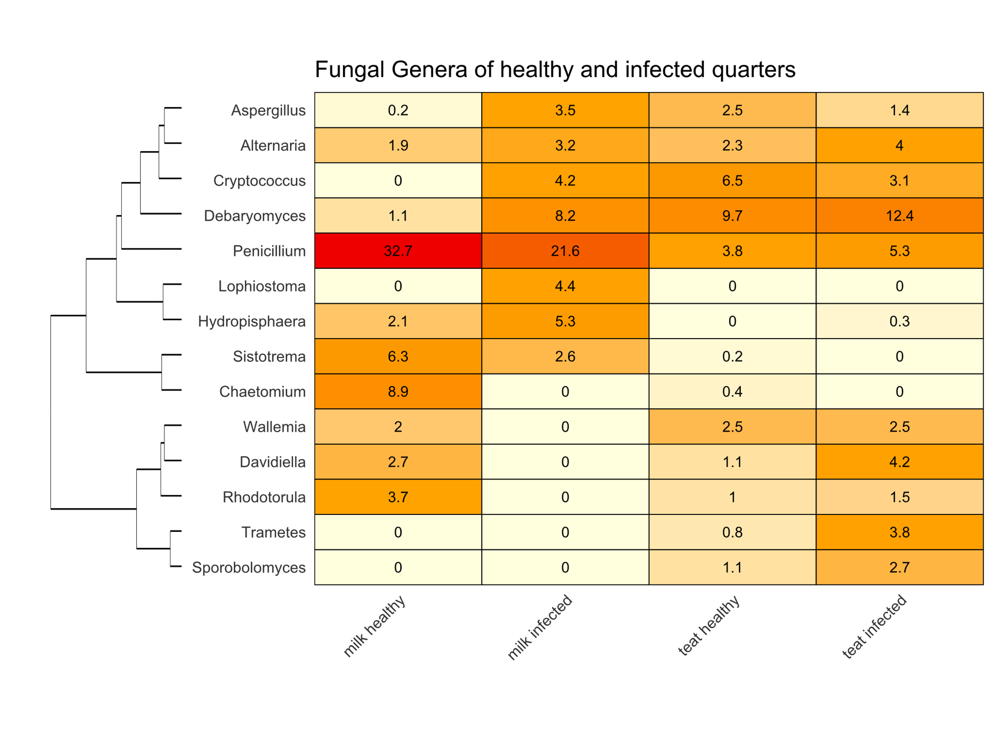
Same pattern in fungal sequences
Notes:
The same pattern in fungi: group of taxa that are only apparent in teat and healthy milk suggesting a flow of microbes between the healthy teat cistern and the bedding environment
Heavy hitter: penicillium greater in healthy milk, though prevalent in both healthy and infected milk, not really skin. Remember: these are Relative, there may actually be higher counts on skin, but less relative to other taxa.. Especially because many more sequences were read in teat samples.
Debaryomyces: yeast higher in infected samples and also found in skin. Lophiostoma, only found in infected milk.
Teat taxa in equal abundance are in different abundance between infection states: some are only present in healthy teats. Suggestive of a commensal milk microbiome that is shared with teat, and thus impacted by the external environment such as bedding. A sign that the healthy microbiota could be modulated by bedding.

Slide 16
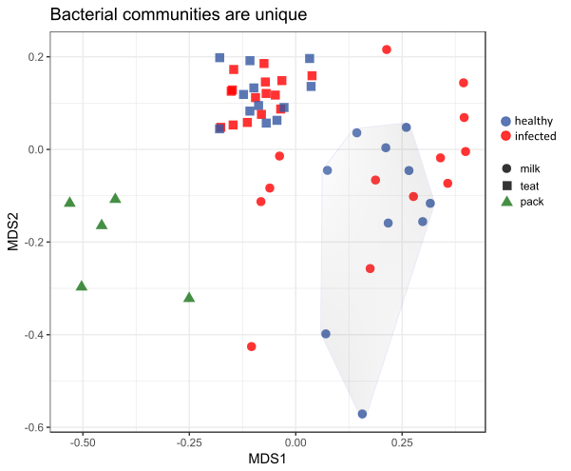
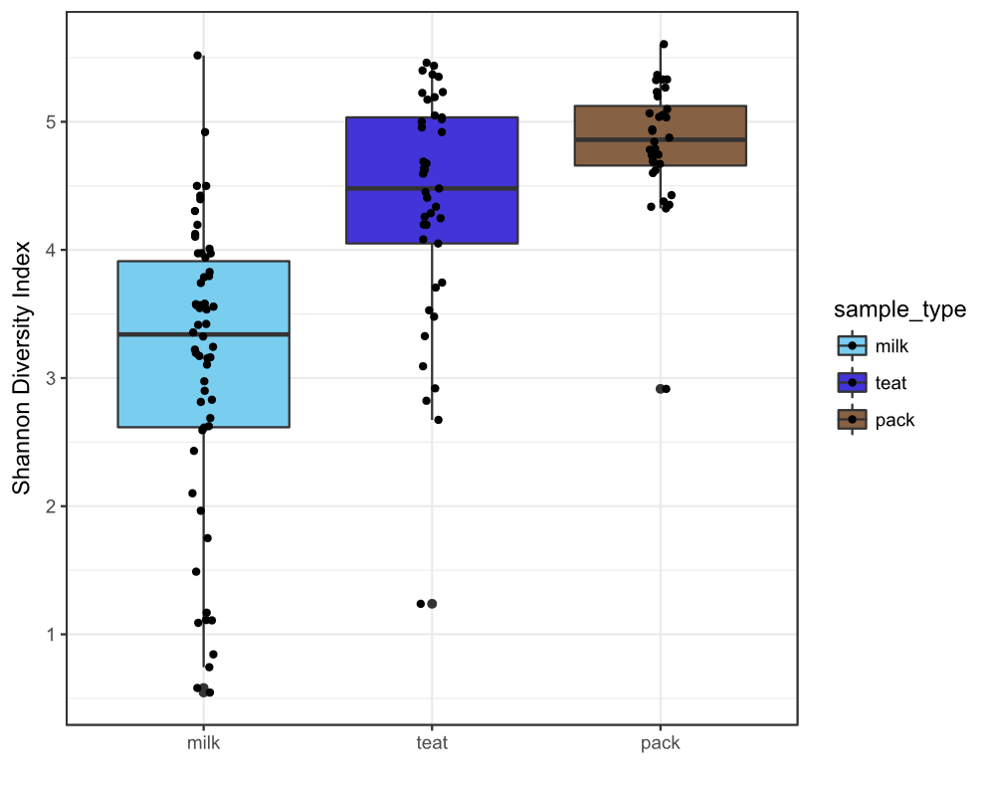

Slide 17
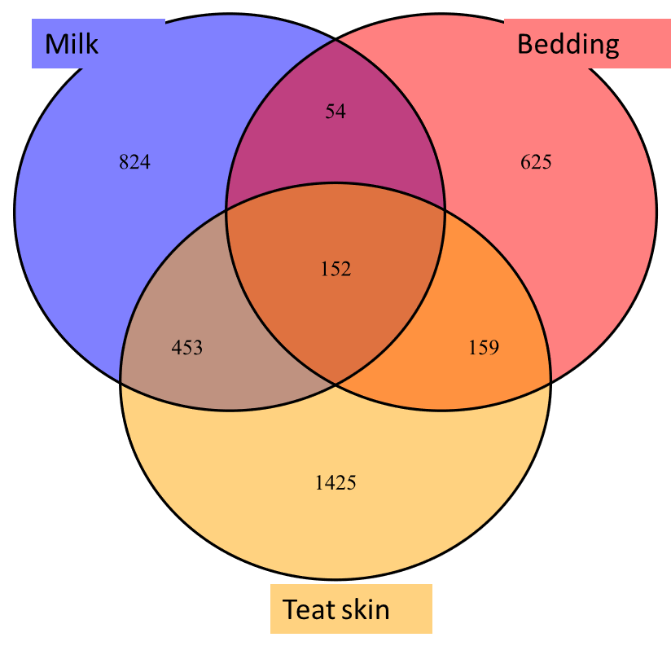
Bedding microbes in healthy quarters
Bedding microbes in infected quarters
Bacteria: teat skin and bedding healthy infected pack
Acinetobacter guillouiae 2.4 0.7 0.5
Acinetobacter lwoffi 0.9 0.1 1.1
Order Clostridiales 0.5 0.5 0.4
Bacteria: milk and bedding
Pseudomonas umsongensis 1.5 0.5 0.1
Ochrobactrum sp. 0.9 0.5 0.1
Acinetobacter guillouieae 1.0 1.3 0.5
Fungi: teat skin and bedding
Debaryomyces prospidis 13.5 19.7 4.1
Kingdom fungi 1.3 0.2 0.2
Penicillium chrysogenum 1.7 1.1 0.1
Fungi: milk and bedding
Debaryomyces prospidis 1.1 4.1 4.1
Notes:
Bacterial genera greater than or equal to 2.5% and Fungal genera ≥5% of total relative abundance in teat or mammary gland also present in bedded pack. Green cells are shared taxa greater in healthy glands, Yellow cells are bedding taxa increased in infected glands.
Debaryomyces and penicillium shared between all habitat states
Corynebacterium and Acinetobacter shared between both habitat states

Slide 18
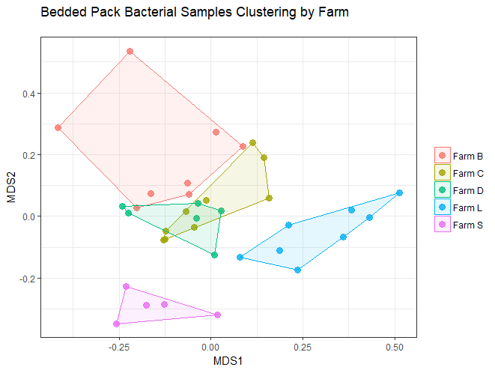
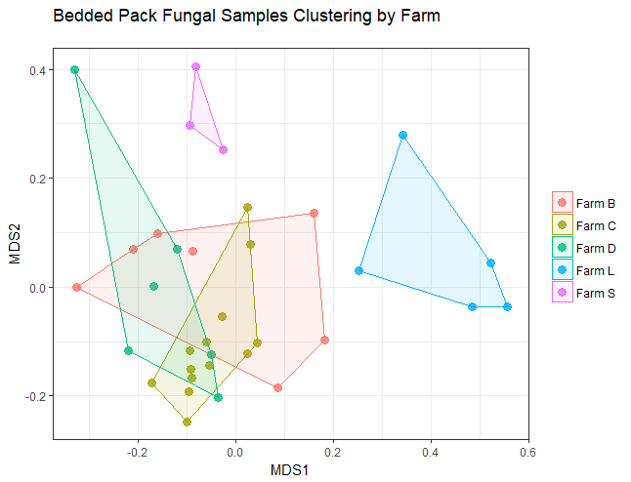
Bedding microbiome shaped by farm and bedding style
Notes:
So if we believe that there are microbes associated with both healthy and infected habitats present in the bedding, is it possible to control this environment to foster the good microbes and discourage the bad ones?
The microbiome of the bedding did appear to be shaped both by farm and by management practices. BDC all clustering : all warm static packs while other two farms are set apart.

Slide 19
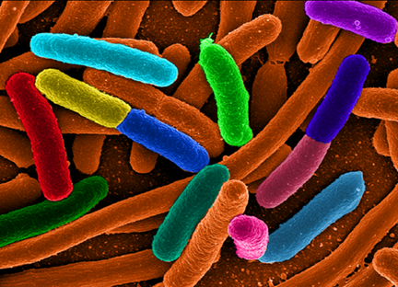
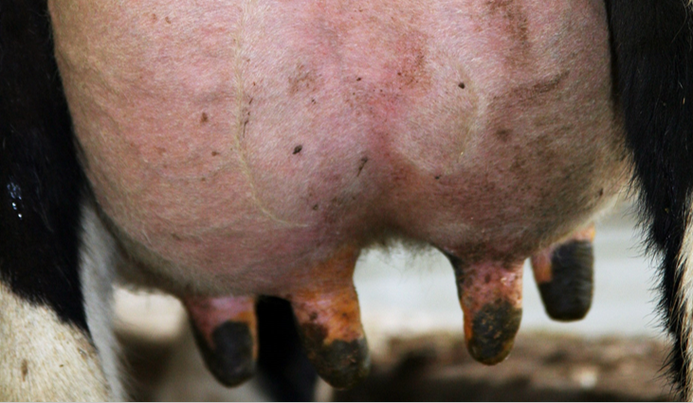
Conclusions
The bedding and mammary environments contain diverse microbial DNA
Teat microbes are shared with milk differently in the infected state
Bedding microbes found on healthy and infected teat skin and milk
Management practices impact bedding microbial community
Notes:
Q’s: Single cow that gets mastitis over time
Compare gut and milk microbiome: immune resistance conferred by bacteria, diet
Genotyping staph species : where are the truly pathogenic bacteria residing
Continue to characterize the microbiome with molecular genetic studies: what are these things actually doing?

Slide 20
New Questions
Is the mammary microbiome shaped by bedding strategy?
Is there a core healthy mammary microbiome that is shared between all cows regardless of bedding, farm, diet etc?
Do bedding microbes inhibit pathogens?
Can bedding management be used to promote “healthy microbes”?

Slide 21
Project Website

Slide 22
Notes:
Products include an economic assessment and best management practices

Slide 24
Next Steps (Objective 1):
Year 1 survey tools
Farm selection process
Critique (strengths and limitations)
survey tools
study design
What are we missing?
Notes:
What is too much of a survey? How long?
Are there any sensitivities that we should be aware of?
Factors that could bias our farm selection?
Are we missing something that would be useful to farmers? E.g., economics (ROI)
In the worst case scenario, we find no health effect, is there something that will generate useful findings regardless of outcome? E.g., does mastitis incidence and severity decrease with bedded pack?
Brian can pick up nutrient management in the economics follow-up

